Slide 1

Binary Heap :Introduction to Heap
A Binary Heap is a Binary Tree with following properties. 1) It’s a complete tree (All levels are completely filled except possibly the last level and the last level has all keys as left as possible). This property of Binary Heap makes them suitable to be stored in an array.
2) A Binary Heap is either Min Heap or Max Heap. In a Min Binary Heap, the key at root must be minimum among all keys present in Binary Heap. The same property must be recursively true for all nodes in Binary Tree. Max Binary Heap is similar to MinHeap.

Slide 2
Heaps can be of two types:
Max-Heap: In a Max-Heap the key present at the root node must be greatest among the keys present at all of it’s children. The same property must be recursively true for all sub-trees in that Binary Tree.
Min-Heap: In a Min-Heap the key present at the root node must be minimum among the keys present at all of it’s children. The same property must be recursively true for all sub-trees in that Binary Tree.

Slide 3
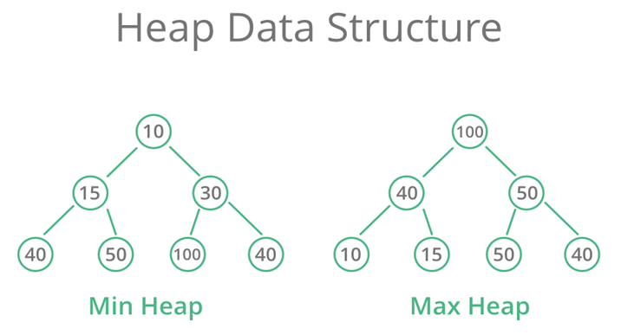

Slide 4
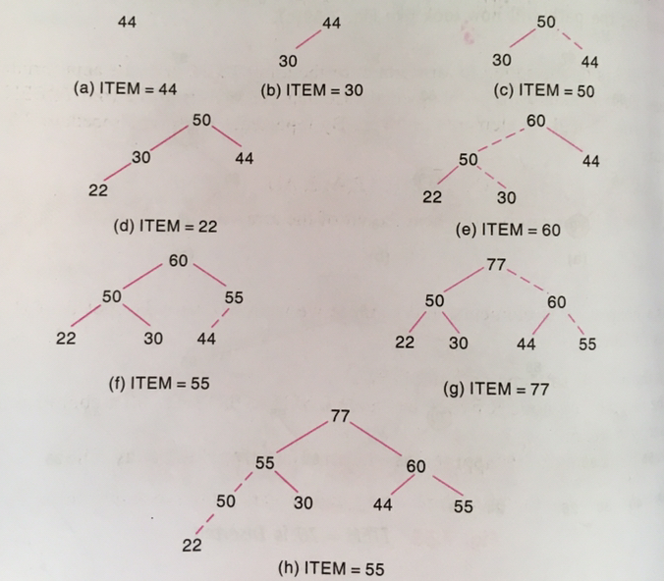
44, 30, 50, 22, 60, 55, 77, 55

Slide 5

Heap Operations : Inserting into a Heap
void insheap(int a[],int n,int item)
{
n=n+1;
ptr=n;
while(ptr>1)
{
par=ptr/2;
if(item<=a[par])
{
a[ptr]=item;
return;
}
a[ptr]=a[par];
ptr=par;
}
a[1]=item;
return;
}

Slide 6
Deletion into a heap
int delheap(int a[], int n, int *item) {
int ptr, left, right, temp;
*item = a[1]; // store root (max element)
temp = a[n]; // last element
n = n - 1;
ptr = 1;
left = 2;
while (left <= n) {
right = left + 1;
// find larger child
if (right <= n && a[right] > a[left])
left = right;
// place temp at correct position
if (temp >= a[left])
break;
a[ptr] = a[left];
ptr = left;
left = 2 * ptr;
}
a[ptr] = temp;
return n;
}

Slide 7
Heap Sort
void heapsort(int a[], int n) { int i, item; // Build heap (using your insertion) for (i = 2; i <= n; i++) { insheap(a, i - 1, a[i]); } // Repeated deletion for (i = n; i >= 2; i--) { n = delheap(a, n, &item); a[i] = item; // place max at end } }

Slide 8
Applications of heap
Priority queues implementation
Heap sort for efficient sorting
Used in graph algorithms like Dijkstra’s and Prim’s

Slide 9
Priority Queue using Heap :
A heap (usually max-heap or min-heap) is used to store elements with priorities.
Insertion: Add element at end and adjust (heapify-up) to maintain heap property.
Deletion: Remove root (highest/lowest priority), replace with last element, and adjust (heapify-down).

